Slide 1












A Guide to Joining
Heroes Welcome UK
Show your support for British Armed Forces

Slide 2
Preface
We hope this guide will help you to better understand the Heroes Welcome ethos and inspire you to consider setting up a Heroes Welcome scheme in your area.
It all started for us here in Scarborough , when a few local businesses now over 500 strong and growing, grouped up together in order to offer our visiting service personnel a warm welcome, special acknowledgement and perhaps a little discount if appropriate. Our resort is very popular with service families and we were tired of hearing media reports regarding members of the Armed Forces not always being made to feel welcome as they should. It occurred to us that we can all thank a helpful police officer, fireman, nurse or doctor but a soldier well he does his/her work "over the Hill and very far away” and we, the Ordinary British Public never really get a chance to say a proper thank you.
Since its inception in 2008 the Heroes Welcome ethos has been adopted by, Towns, Cities and Regions from all corners of the United Kingdom and our community network continues to grow steadily.
Our Scheme is free to join, flexible and simple to operate, all we ask is that if you do join, then you show your open support to service personnel in a way that is both meaningful and appropriate. We liaise closely with, military charities, regimental associations, the Armed Forces Day and the Community Covenant Teams to ensure that our message of support is unambiguous and does indeed get through to those who appreciate it most i.e. junior ranks, their families and dependants.
So if you agree with our sentiments, then join us in helping to remind our Heroes that they are indeed very Welcome.
John Senior MBE
Heroes Welcome UK

Slide 3






















































Heroes Welcome Members Oct 2015
Royal
Wootton Bassett

Slide 4
The Forces Audience
35,000
90,000
45,250
TA 32,000
Total Strength 202,250 + Dependants

Slide 5

Mission Statement
“To encourage British, Cities, Towns
and Organisations to join Heroes Welcome UK, in order to give, support, quiet recognition and a little extra hospitality to Armed Forces Personnel and their families.”

Slide 6
Aims
“In 2010 the UK Government asked Communities to show their positive support to those serving in the British Armed Forces by signing up to the Armed Forces Community Covenant. We believe that taking ownership of Heroes Welcome goes some way to fulfilling this fine aspiration.”
“In 2012 the Royal British Legion’s Community Covenant Guide to Good Practice recommends Heroes Welcome UK as one way in which a community can show its open support to those serving in the Armed Forces, for a copy of the guide please go to our website and click on the link in downloads.”
To provide a sustainable and simple vehicle to allow communities/organisations to express their quiet acknowledgement and gratitude to the Men and Women of the British Armed Forces in a direct and positive manner.
To inform Service Personnel and their families where and when they may enjoy the benefits of a Heroes Welcome.

Slide 7
Principles of Delivery
Simplicity
The scheme is designed to be simple and robust. Control measures are kept to a minimum and are only in place where required to ensure co-ordinated delivery of the message.
Flexibility
Individual members are able to choose a discount or offer that suits their own style of business. There is no minimum or maximum all we ask is that in taking membership of Heroes Welcome UK, you enter into the spirit of the initiative.
Delegation
In order to simplify administration we have delegated responsibility for the delivery of Heroes Welcome to all three levels of membership.
UK – Regional – Individual

Slide 8

Military Discounts
“No plan survives contact with the enemy”
Heroes Welcome UK is pleased to be able to announce its recent affiliation with the British Armed Forces only official discount scheme, Defence Discount Service.
Heroes Welcome UK is not a discount scheme however, many of our small business members do offer service enhancements and they are able to continue as part of the Heroes Welcome.
Defence Discount Service will allow businesses of all size to offer their discounts to the Armed Forces for free including small businesses.
What our partnership will bring is access to the only bespoke and official forces discount scheme which will benefit those serving in the Armed Forces.
For details and information please visit : www.defencediscountservice.co.uk

Slide 9
Working within the Community Covenant
1 UK------------------------------------------------------------------------------------------------
2 Regional-----------------------------------------------------------------------------------------
3 Individual--------------------------------------------------------------------------------------
Forces Charities
Heroes Welcome UK
Community Partnership
Defence Discount Service
Heroes Welcome in West Norfolk
Co-ordinator
Café Fish
ZippyTaxi
National Retail
Outlets

Slide 10
Delivery Tasks
Level 1. UK – “Providing the Tools”
Management of UK Web Site & Regional portals
Regional Starter Packs - Initial printing of stickers with regional logo, advice on website
Provide a Co-ordinator Help Line
Information stream to UK Armed Forces – BFBS – Service Magazines – The Army Hive
Liaise with Heroes Welcome regional members
Co-ordinate National Publicity
Level 2. Regional – “Keeping It simple”
Form a Delivery Group/Local council/Newspaper/Town Manager/ Tourism Associations
Appoint local co-ordinator
Brief regional press and media to create local public awareness
Recruit local business membership and community support
Liaise with Heroes Welcome UK re sticker production and distribution
Launch and maintain regional Heroes Welcome web site
Inform service personnel by publicity and posters at local units and Military bases etc.
Level 3. Individual – “This is your scheme you have control”
Manage your offer and publicity responsibly and make a difference!

Slide 11
Control Measures
Members must agree to abide by the following simple rules:
To operate their scheme exclusively for the benefit of members of the British Armed Forces, Veterans and direct dependants thereof.
Not to change or adapt the Heroes Welcome Logo without the written consent of the organiser.
Not to allow the Heroes Welcome name to be used for individual or commercial gain.
To register their scheme on the Heroes Welcome UK website.

Slide 12
Are you inspired to set up Heroes Welcome?
It’s as easy as 1
Step 1 - Preliminaries
Identify and engage the support of key individuals and groupings:
Local Authority - Press - Royal British Legion –
Tourism Associations - Chamber of Trade –
Town Centre Manager - Community Leaders –
Military Base Commanders.
Publicise your intention to launch using local press and media

Slide 13
Are you inspired to set up Heroes Welcome?
It’s as easy as 2
Step 2 - Stickers, Posters and Website
The Heroes Welcome logo is adaptable to your area and can be freely used on stickers, posters, websites and other promotional material
( By the kind Permission of Johnston Press)
You may of course produce your own, but if this is not practical then:
Bespoke Stickers for your region are available at a cost of 43p each on
14 day turn around. Contact Matt at Blue Raptor Signs & Displays,
Tel: 01723 866688 or Email: matt@blueraptorsigns.com
Posters and Promotional material can be produced using the Heroes Welcome PDF and Free Poster available from the joining page.
Webpage and Members listings can be set up by our website designers £100.00, or at your own arrangement. Initially you may prefer a simple link from your Tourism/Civic web site. Contact: Jason at Studio Betton, Tel: 01723 866058 or Email: studio@bettondesign.co.uk

Slide 14
Are you inspired to set up Heroes Welcome?
It’s as easy as 3
Step 3 - Role Out and Maintenance
Arrange for circulation of stickers and posters
Encourage members to download PDF logo for inclusion in their corporate websites
Liaise with Website host to update member listings
Co-ordinate Press and PR with Heroes Welcome UK
Monitor progress and encourage new membership
Publicise your scheme to the British Armed Forces at every opportunity
1-2-3

Slide 15








Example of a Regional Web Page
Welcome to the Heroes Welcome website Be sure of a Warm Welcome at Yorkshire's Premiere Resort The aim of the initiative is to give a warm Scarborough welcome and a little quiet acknowledgment to members of Her Majesty’s Armed Forces who are doing a difficult job in dangerous circumstances. To view the current list of supporters please click here When displayed The Heroes logo may indicate an Armed Service Discount or Upgrade Offer or at the very least a warm welcome [back to main UK index]
All information ©2009 Heroes Welcome UK | website by bettondesign.co.uk

Slide 16
Frequently Asked Questions
Is there anything like Heroes Welcome in existence? Not in the UK, we believe that we are
unique in creating a simple method for communities to show support and acknowledgment
towards the British Armed Forces.
Are you a charity? No, we have no fund raising aims, however we do support Military Charities
such as: Help for Heroes, the Royal British Legion and SSAFA.
What do the Troops make of Heroes Welcome? We have had thousands of messages of support
from troops and members of the public. A common observation is, why aren't other places doing
something similar, well now they are!
Does it cost a lot of time and money to set up? We don’t think so, around £350.00, including the
webs site set up and 500 stickers (as at May 2016). Once up and running, around an hour a week
is all that is required to update and manage the scheme.
Can we change the logo? Not really, service personnel moving around the UK need to be able to
identify with the scheme. However, your posters can include whatever you feel appropriate to be
attractive to your local service groupings i.e. RN, Royal Marines, Army, RAF etc.
How do we fund this? You may choose to: Ask for donations, sell the stickers on at say 50p each
or you might wish to add it to your Armed Forces Day Budget as part of the funding submission.
Any complaints or adverse comment? Up to now we have had no record of either.

Slide 17
Forward & Together As One
The key to success is simplicity and the shared ownership of responsibility.
Each Region bringing its own expertise to bear in order to deliver the common aim of:
Providing a Heroes Welcome to The Men and Women of Her Majesty’s Armed Forces

Slide 18
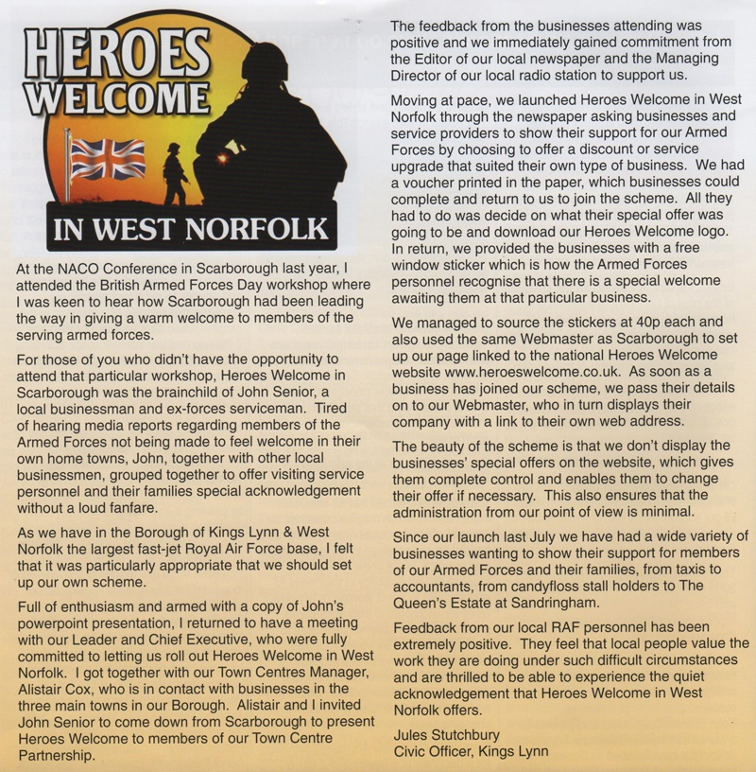
A Civic’s Guide Jules Stutchbury NACO 2009

Slide 19
Reactions and Comments
“Well done Kings Lynn, I do hope other towns will follow your lead!”
HRH The Prince Of Wales
“This simple scheme is very much appreciated by all those serving in the Armed Forces.”
Lord Dannatt KCB CBE MC
“Heroes Welcome is an excellent scheme and my soldiers really do appreciate the support shown to themselves and their loved ones ”
Lt Col Toby Gray Commanding Officer, 1st Battalion Coldstream Guards
“Fantastic idea, we really felt wanted, thanks very much Kings Lynn, we need more like you!”
CSM Slim24 E-mail
“Thank you very much Heroes Welcome Dorchester, the boys really appreciate what you are doing”
OC A Squadron, Kings Royal Hussars
“This is something very special and means a lot to all of us”
Captain AV 2nd Battalion The Yorkshire Regiment (GH)
”We are all very proud to be able to show Hampshire’s open support to members of the Armed Forces.” Anna McNair Scott, Chairman Hampshire County Council

Slide 20
Contact Details www.heroeswelcome.co.uk
National Co-ordinator
John W Senior MBE TD
captsen1@aol.com
Administrator
Clive Linton (former RM)
clivelinton@aol.com
Heroes Welcome UK
4 Sandside
Scarborough
North Yorkshire
United Kingdom
YO11 1PE
Tel: 01723 364042
Sticker Production
Blue Raptor Signs & Displays
Unit 3 & 4 Newchase Court
Hooper Hill Road
Eastfield
Scarborough
North Yorkshire
United Kingdom
YO11 3YS
Tel: 01723 866688
Email: matt@blueraptorsigns.com
Website Design & Management
Betton Design
Tel: 01723 866058
E mail: studio@bettondesign.co.uk

